Slide 1

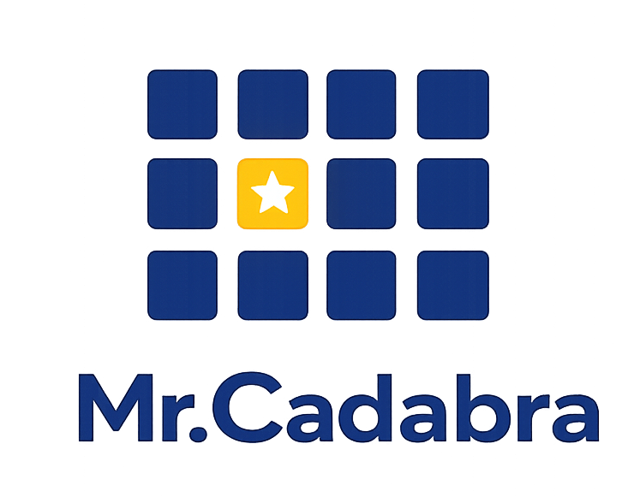
• FOR PARENTS •
— AI-Powered Tutor —
Your child’s personal math tutor
✓ Complete visibility into your child’s learning.
✓ Complete control over your family's data.
mrcadabra.com
Notes:
As a parent, you want a great math tutor for your child—and complete visibility and control for yourself. Let's see how Mr. Cadabra brings it all together.

Slide 2

What matters most to parents
⭐ Your parent view
A clear view of progress and where to help next.
⭐ Your child's learning
A patient tutor that teaches, not just answers.
⭐ Your family's privacy
Complete control of your family's data.
Notes:
Every parent has three questions: What will my child experience? What will I be able to see? And how is my family's data protected? Let's look at each one.

Slide 3
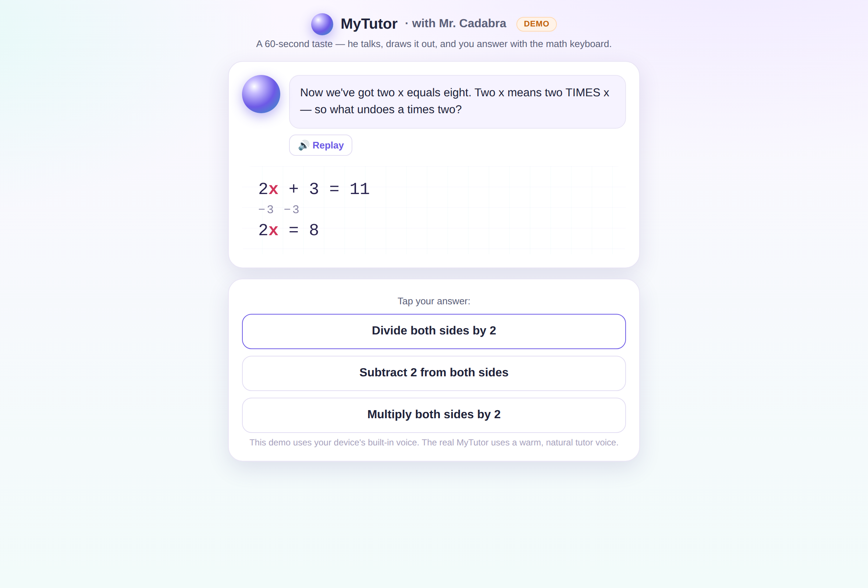
A tutor that teaches — never just answers
Mr.Cadabra explains out loud, draws every step, and asks the next question instead of giving the answer.
He's math-only and won't be talked off topic — even when kids try.
Notes:
First, your child’s learning. Mister Cadabra teaches like a great tutor—explaining every step, asking the next question, and keeping every lesson focused on math.

Slide 4
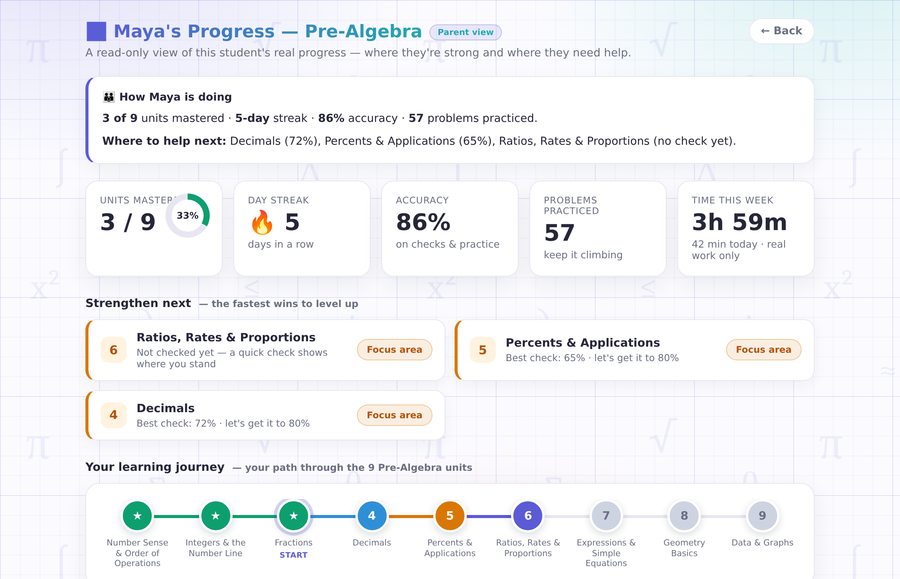
See what matters
Your parent code opens a read-only dashboard with your child's progress, where help is needed next, and real scores from real checks.
Notes:
Second, what you see. Your own parent code opens a read-only view of your child's real progress — what's mastered, what they're working on, and where to help next.

Slide 5
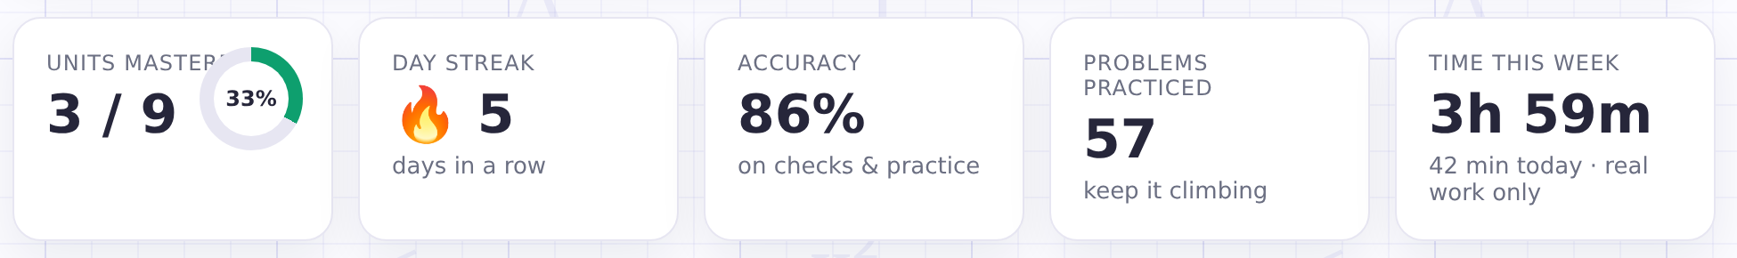
Honest time, honest numbers
A minute counts only when your child is actually working — walk away or switch tabs and the clock stops.
"42 minutes today" means 42 minutes of math.
Notes:
We track time honestly. The clock runs only while your child is actively learning. Walk away or switch tabs, and it stops. Every week, you'll receive a progress email.

Slide 6




Privacy promises we can keep
No voice recording kept
Never sold, no ads
You hold the keys
Voice recordings are discarded after each task is evaluated.
We never sell student data. Children are never asked for an email, phone number, photos, or location.
You control the account—and if you ever want your child's data deleted, just let us know.
Notes:
And third—your family's data. Voice recordings are never kept. We never sell student data or show ads. You control the account and can delete your child's data at any time.

Slide 7
See Mr.Cadabra in action.
— AI-Powered Tutor —
Watch one short lesson and see if it's right for your family.
mrcadabra.com/demo
Notes:
The best way to judge Mister Cadabra is to try a lesson yourself. It takes just two minutes, with no sign-up required. Visit MisterCadabra.com/demo—we'd love to hear what you think.

